Slide 1
User Interaction – CSIT226/CSIT826
CSIT226/CSIT826

Slide 2
Dr. Mark Freeman
School of Computing and Information Technology
Faculty of Engineering and Information Sciences

Slide 3
This Week
Review of User-Centered Design
How do users interact with systems?
Cognitive Aspects
Social Interaction

Slide 4
 | Topic | Reading
1 | Subject Overview and Introduction to HCI | Chapter 1
2 | User-Centred Design | Chapter 2
3 | User Interaction | Chapters 3 & 4
4 | User Interfaces | Chapters 5 & 6
5 | Information Presentation and Navigation | No Readings
6 | Accessibility and Special Issues in HCI | No Readings
7 | Interaction Design and Development I: Data Gathering and Analysis | Chapters 7 & 8
8 | Interaction Design and Development II: Requirements and Modelling | Chapters 9 & 10
9 | Interaction Design and Development III: Prototyping | Chapters 11 & 12
10 | No Classes: Public Holiday | No Readings
11 | Usability Evaluation Methods I | Chapter 13
12 | Usability Evaluation Methods II | Chapters 14 & 15
13 | Future HCI & Subject Revision | No Readings

Slide 5
Subject Description
The subject provides students with an understanding of Human Computer Interaction (HCI) principles and practices, and how to apply them in the context of developing usable interactive computer applications and systems. The subject also emphasises the importance of taking into account contextual, organisational, and social factors in the design of computer systems. Students will be taken through the analysis, design, development, and evaluation of user interfaces. They will acquire hands-on design skills through an interaction design project. The subject will cover topics including user-centred design, the development process, prototyping, usability testing, measuring and evaluating the user experience and accessibility.

Slide 6
Subject Learning Outcomes (SLOs)
On successful completion of this subject, students will be able to:
Identify and describe HCI principles and design issues.
Discuss and justify HCI solutions based on design principles.
Demonstrate an understanding of the HCI design process.
Acquire skills to design and implement user-centred design.
Select and use suitable methods of measuring and evaluating the user experience.

Slide 7
User-Centered Design - Recap

Slide 8
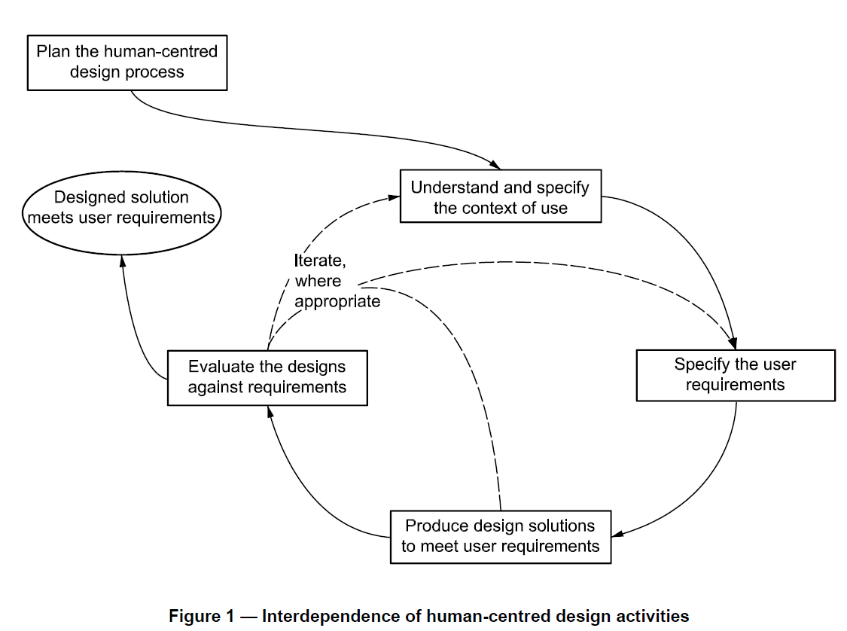

Slide 9
User-Centered Design
"development proceeds with the user as the center of focus." (Rubin, 2008)
Rubin depicts the User-Centered Design Process as follows:
The users are in the center of a double circle
The inner ring contains: Context; Objectives; Environment and Goals
The outer ring contains: Task Detail; Task Content; Task Organization and Task Flow

Slide 10
User Interaction

Slide 11
What wrong with this?

Slide 12
History
Command Line Interfaces (CLI)
Graphical User Interfaces (GUI)
Natural User Interfaces (NUI)

Slide 13
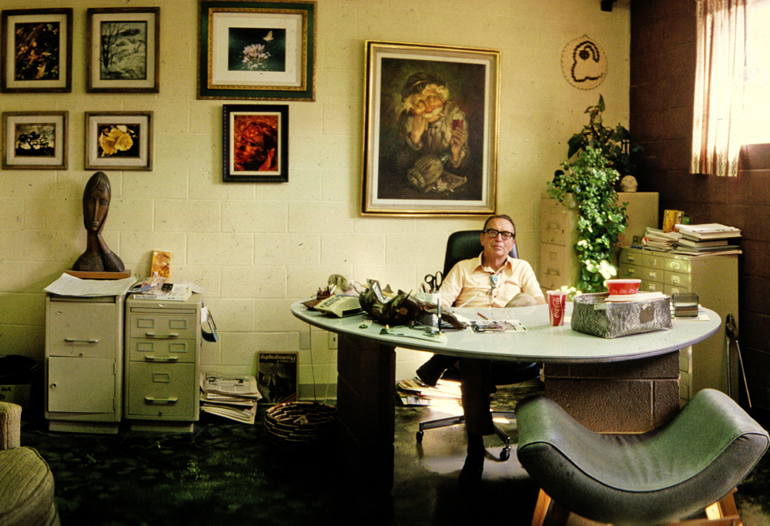
A 1970’s office

Slide 14
Skeuomorphism
Skeuomorphism
Flat Design (Minimalism)

Slide 15
Common Interaction Styles
Command line interface
Menus
Natural language
Question/answer & query dialogue
Form-fills & spreadsheets
WIMP, point & click
Handwriting
3D interfaces, VR, augmented reality
Touch, gesture, eye-tracking, brain-tracking, voice control

Slide 16
SAP R/3 vs. SAP S/4
A change in the user interface

Slide 17
Mobile: Consider layers of operation
0
8
9
6
7
4
5
2
3
0
1
Layer 1: Hardware
Layer 2: Operating System
Layer 3: Application

Slide 18
4th Layer
In browser applications

Slide 19
Theoretical framework – Activity Theory
human activity = subject + object + mediation tool
(Vygotsky, 1978; Leontiev, 1978, 1981; Engestrom, 1999)
Tool
Subject
Object
Transformation Process
Outcome
Rules
Community
Division of Labour

Slide 20

Chapter 3
COGNITIVE ASPECTS

Slide 21
Why do we need to understand users?
Interacting with technology is cognitive
Need to take into account cognitive processes involved and cognitive limitations of users
Provides knowledge about what users can and cannot be expected to do
Identifies and explains the nature and causes of problems users encounter
Supply theories, modelling tools, guidance and methods that can lead to the design of better interactive products
Notes:
21

Slide 22
Cognitive processes
Attention
Perception
Memory
Learning
Reading, speaking and listening
Problem-solving, planning, reasoning and decision-making
Notes:
22
It is important to note that many of these cognitive processes are interdependent: several may be involved for a given activity. It is rare for one to occur in isolation. For example, when you try to learn material for an exam, you need to attend to the material, perceive and recognize it, read it, think about it, and try to remember it. Below we describe the various kinds in more detail, followed by a summary box highlighting core design implications for each. Most relevant for interaction design are attention and memory which we describe in greatest detail.

Slide 23
Attention
Selecting things to concentrate on at a point in time from the mass of stimuli around us
Allows us to focus on information that is relevant to what we are doing
Involves audio and/or visual senses
Focussed and divided attention enables us to be selective in terms of the mass of competing stimuli but limits our ability to keep track of all events
Information at the interface should be structured to capture users’ attention, e.g. use perceptual boundaries (windows), colour, reverse video, sound and flashing lights
Notes:
23

Slide 24

Activity: Find the price for a double room at the Quality Inn in Pennsylvania a
Notes:
24

Slide 25

Activity: Find the price of a double room at the Holiday Inn in Columbia
Notes:
25

Slide 26
Activity
Tullis (1987) found that the two screens produced quite different results
1st screen - took an average of 5.5 seconds to search
2nd screen - took an average of 3.2 seconds to search
Why, since both displays have the same density of information (31%)?
Spacing
In the 1st screen the information is bunched up together, making it hard to search
In the 2nd screen the characters are grouped into vertical categories of information making it easier
Notes:
26

Slide 27
Perception
How information is acquired from the world and transformed into experiences
Obvious implication is to design representations that are readily perceivable, e.g.
Text should be legible
Icons should be easy to distinguish and read
Notes:
27

Slide 28
Is colour contrast good? Find Italian
Notes:
28

Slide 29
Are borders and white space better? Find french
Notes:
29

Slide 30
Activity
Weller (2004) found people took less time to locate items for information that was grouped
using a border (2nd screen) compared with using colour contrast (1st screen)
Some argue that too much white space on web pages is detrimental to search
Makes it hard to find information
Do you agree?
Notes:
30

Slide 31
Design implications
Icons should enable users to readily distinguish their meaning
Bordering and spacing are effective visual ways of grouping information
Sounds should be audible and distinguishable
Speech output should enable users to distinguish between the set of spoken words
Text should be legible and distinguishable from the background
Tactile feedback should allow users to recognize and distinguish different meanings
Notes:
31

Slide 32
Activity
Try to remember the dates of your parents’ birthday
Try to remember the cover of the last two Movies you watched, bought or rented
Which was easiest? Why?
People are very good at remembering visual cues about things
e.g. the colour of items, the location of objects and marks on an object
They find it more difficult to learn and remember arbitrary material
e.g. birthdays and phone numbers
Notes:
32

Slide 33
Recognition versus recall
Command-based interfaces require users to recall from memory a name from a possible set of 100s
Web browsers
Notes:
33

Slide 34
Design implications
Don’t overload users’ memories with complicated procedures for carrying out tasks
Design interfaces that promote recognition rather than recall
Provide users with various ways of encoding information to help them remember
e.g. categories, colour, flagging, time stamping
Notes:
34

Slide 35
Mental models
Users develop an understanding of a system through learning about and using it
Knowledge is sometimes described as a mental model:
How to use the system (what to do next)
What to do with unfamiliar systems or unexpected situations (how the system works)
People make inferences using mental models of how to carry out tasks
Notes:
35

Slide 36
Mental models
Craik (1943) described mental models as:
internal constructions of some aspect of the external world enabling predictions to be made
Involves unconscious and conscious processes
images and analogies are activated
Deep versus shallow models
e.g. how to drive a car and how it works
Notes:
36

Slide 37
Everyday reasoning and mental models
You arrive home on a cold winter’s night to a cold house.
How do you get the house to warm up as quickly as possible? Set the thermostat to be at its highest or to the desired temperature?
Notes:
37

Slide 38
Exercise: ATMs
Write down how an ATM Australian works
How much money are you allowed to take out?
What denominations?
If you went to another machine and tried the same what would happen?
What information is on the strip on your card? How is this used?
What happens if you enter the wrong number?
Why are there pauses between the steps of a transaction? What happens if you try to type during them?
Why does the card stay inside the machine?
Do you count the money? Why?
Notes:
38

Slide 39
Chapter 4
SOCIAL INTERACTION

Slide 40
Overview
Being social
Face to face conversations
Remote conversations
Tele-presence
Co-presence
www.id-book.com

Slide 41
Being social
Are F2F conversations being superseded by our social media interactions?
How many friends do you have on Facebook, LinkedIn,etc vs real life?
How much overlap?
How are the ways we live and interact with one another changing?
Are the established rules and etiquette still applicable to online and offline?
www.id-book.com
Notes:
Are the ways we live and interact with one another changing? Have the conventions, norms and rules–that have been established in face-to-face interactions to maintain social order been able to migrate to social media interactions? In particular, are the established conversational rules and etiquette – whose function it is to let people know how they should behave in social groups – also applicable to online social behaviour?
41

Slide 42
Conversational rules
Sacks et al. (1978) work on conversation analysis describe three basic rules:
Rule 1: the current speaker chooses the next speaker by asking an opinion, question, or request
Rule 2: another person decides to start speaking
Rule 3: the current speaker continues talking
www.id-book.com

Slide 43
What happens in social media conversations?
Do same conversational rules apply?
Are there more breakdowns?
How do people repair them for:
Phone?
email?
Instant messaging?
texting?
On Skype?
Do they mimic or move beyond existing ways of conversing?
www.id-book.com
Notes:
have new conversational mechanisms evolved for the various kinds of social media? For example, do people greet each other in the same way, depending on whether they are chatting online, Skyping or at a party? Do people take turns when online chatting in the way they do when talking with each other face-to-face? In order to answer these questions we next describe the core social mechanisms that exist in face-to-face interactions, followed by a discussion of the extent to which they remain or have been replaced with other mechanisms in online interactions.
On the phone: The person answering the call will initiate the conversation by saying “hello” or more formally, the name of their company/department (and sometimes the phone number being called). Many phones now have caller ID letting the person answering the call know who he is talking to, which can enable him to be more personal, e.g. “Hello John, how are you doing?” Phone conversations usually start with a mutual greeting and end with a farewell one.
In contrast, conversations that take place via online chatting or IM have evolved new conventions. The use of opening and ending greetings when joining and leaving are rarely used; instead most people simply start their message with what they want to talk about, and then stop when they have got an answer, as if in the middle of a conversation
43

Slide 44
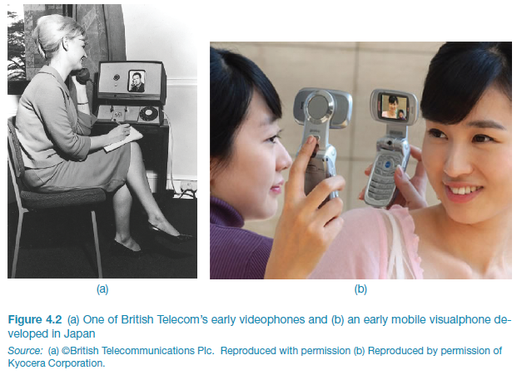
Early videophone and visualphone
www.id-book.com
Notes:
Figure 4.1

Slide 45
Coordination mechanisms
When a group of people act or interact together they need to coordinate themselves
e.g., playing football, navigating a ship
They use:
verbal and non-verbal communication
schedules, rules, and conventions
shared external representations
www.id-book.com

Slide 46
Co-presence
Technologies that enable co-located groups to collaborate more effectively
when working, learning and socializing
Examples: Smartboards, Surfaces, Wii and Kinect
www.id-book.com

Slide 47
F2F coordinating mechanisms
Talk is central
Non-verbal also used to emphasize and as substitute
e.g. nods, shakes, winks, glances, gestures and hand-raising
Formal meetings
explicit structures such as agendas, memos, and minutes are employed to coordinate the activity
www.id-book.com

Slide 48
Awareness mechanisms
Involves knowing who is around, what is happening, and who is talking with whom
Peripheral awareness
keeping an eye on things happening in the periphery of vision
Overhearing and overseeing - allows tracking of what others are doing without explicit cues

Slide 49
Summary
Cognition involves several processes including attention, memory, perception and learning
The way an interface is designed can greatly affect how well users can perceive, attend, learn and remember how to do their tasks
Theoretical frameworks, such as mental models and external cognition, provide ways of understanding how and why people interact with products
This can lead to thinking about how to design better products
Social mechanisms, like turn-taking, conventions, etc., enable us to collaborate and coordinate our activities
Keeping aware of what others are doing and letting others know what you are doing are important aspects of collaborative working and socialising
Many technologies systems have been built to support telepresence and co-presence
Notes:
49

Slide 50
Questions

